Slide 1



STAT 5414 :
Web Traffic Time Series Forecasting
Forecast future traffic to Wikipedia pages
SONAM DEVADIGA
05/05/2020

Slide 2
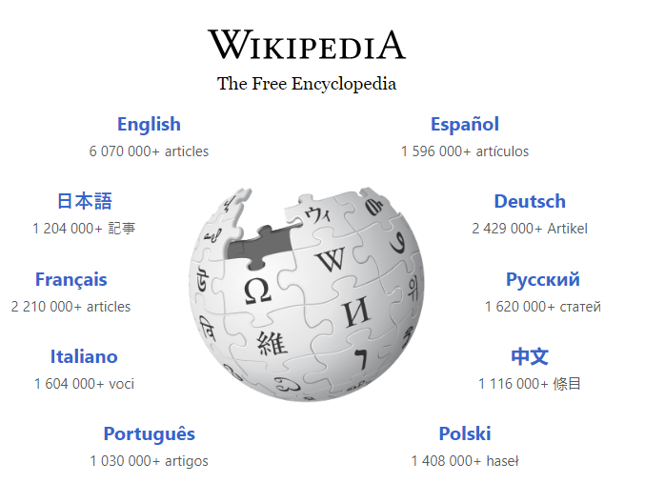
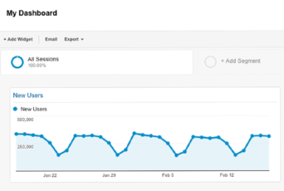
OBJECTIVES
Sequential or temporal observations emerge in many key real-world problems, ranging from biological data, financial markets, weather forecasting, to audio and video processing.
The Web-traffic to Wikipedia pages also tend to follow these sequential or temporal patterns
The problem of forecasting the future values of multiple time series, has always been one of the most challenging problems in the field.
This project aims at selecting and analyzing select Wikipedia pages and using Box-Jenkins and State of the Art models to forecast future values

Slide 3

Method
Methods | AR(p) | ARIMA(p,d,q)
Type | Box-Jenkins | Box-Jenkins
Explanation | An auto regressive (AR(p)) component is referring to the use of past values in the regression equation for the series Y. The auto-regressive parameter p specifies the number of lags used in the model. | The auto-regressive parameter p specifies the number of lags used in the model. The d represents the degree of differencing in the integrated (I(d)) component. A moving average (MA(q)) component represents the error of the model as a combination of previous error terms e_{t}. The order q determines the number of terms to include in the model Differencing, autoregressive, and moving average components
Equation | For example, AR(2) or, equivalently, ARIMA(2,0,0), is represented as where φ1, φ2 are parameters for the model. | where y_{d} is Y differenced d times and c is a constant.
Remarks |  | The model above assumes non-seasonal series These models directly rely on past values, and therefore work best on long and stable series. ARIMA simply approximates historical patterns and therefore does not aim to explain the structure of the underlying data mechanism.
Notes:
model above assumes non-seasonal series, which means you might need to de-seasonalize the series before modeling.

Slide 4
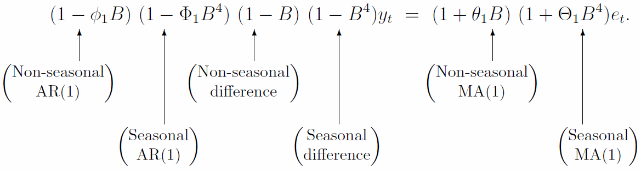
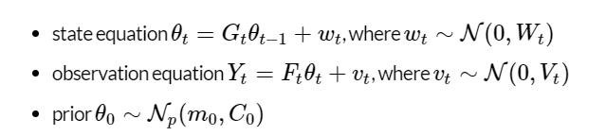
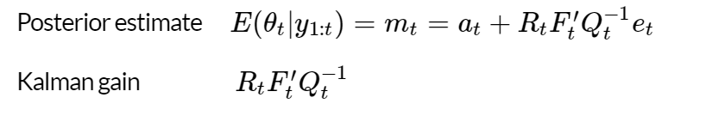
Method
Methods | SARIMA(p,d,q) (P,D,Q) | Dynamic Linear Method (DLM)
Type | Box-Jenkins | State-space-model
Explanation | ARIMA models can be also specified through a seasonal structure. In this case, the model is specified by two sets of order parameters: (p, d, q) as described for ARIMA and (P, D, Q)m parameters describing the seasonal component of m periods | In theory, any and all of: system noise, observation noise, state equation and observation equation could change over time. At any time, we have a current best estimate on where the state-space is (given past observations) We compute the next true position (state) based on the state equation (this is the prior) We predict the corresponding observation based on the observation equation (this is the likelihood) As soon as the new observation arrives, we can correct our estimate and compute the posterior on the state
Equation
Remarks |  | Kalman filter is used to correct our prediction by how much it differs from the incoming observation
Notes:
Kalman filter in a nutshell
We correct our prediction by how much it differs from the incoming observation.

Slide 5
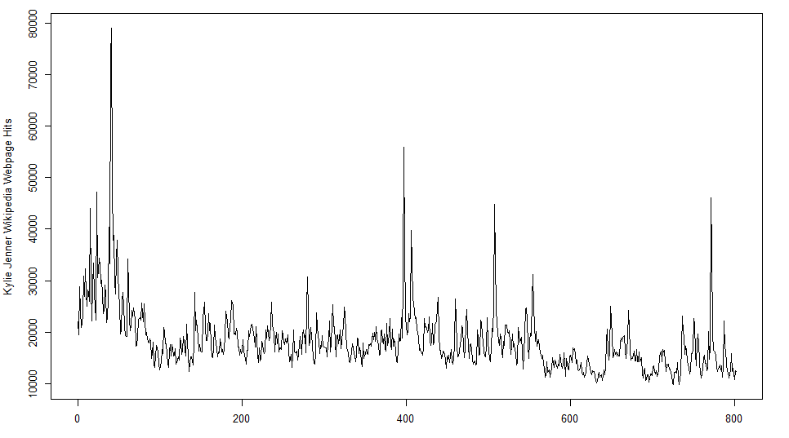
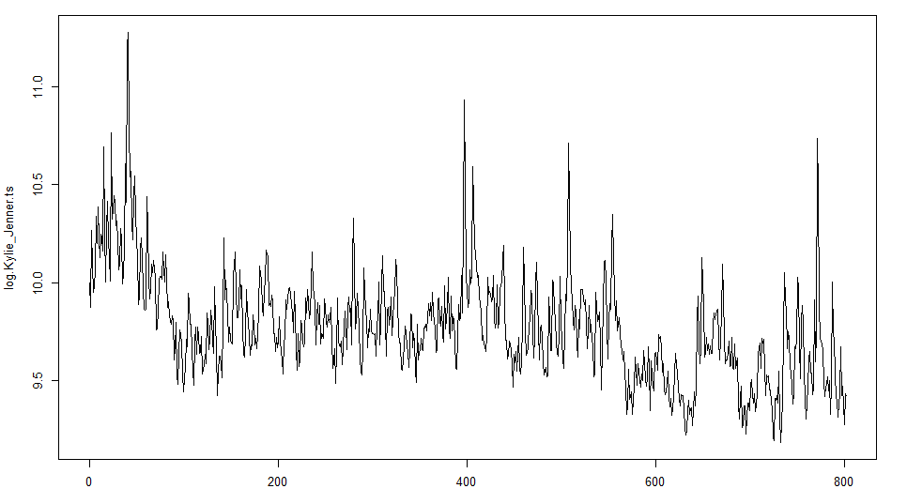
Data : Kylie Jenner Time Series
Actual Plot
Log Differential
Observed mean = 18267.66
Observed mean = 9.771454
Observed variance = 38217289
Observed variance = 0.07450695
Data : 800 points recorded every day

Slide 6
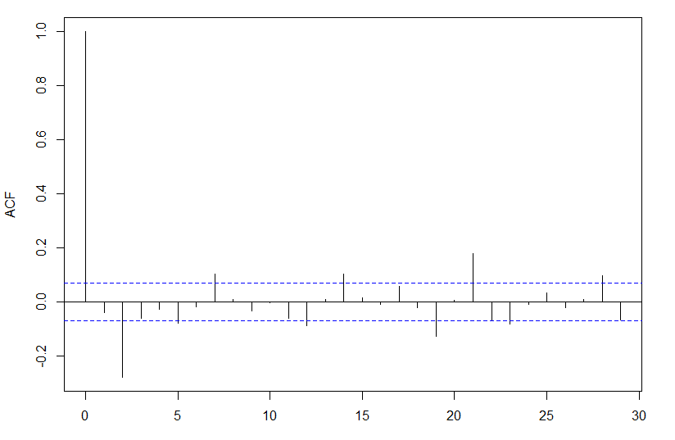
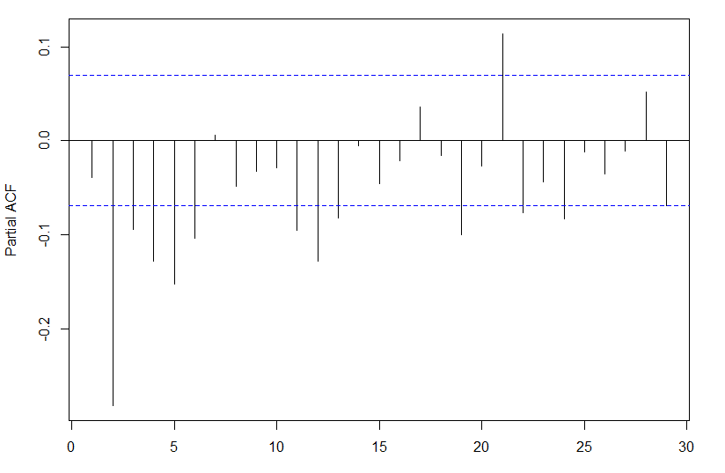
ACF & PACF

Slide 7
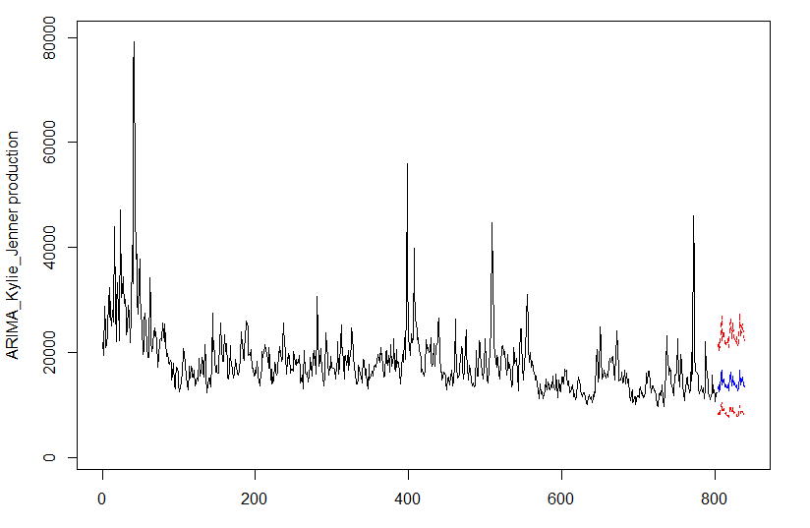
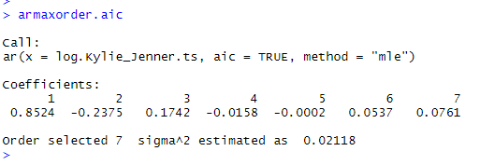
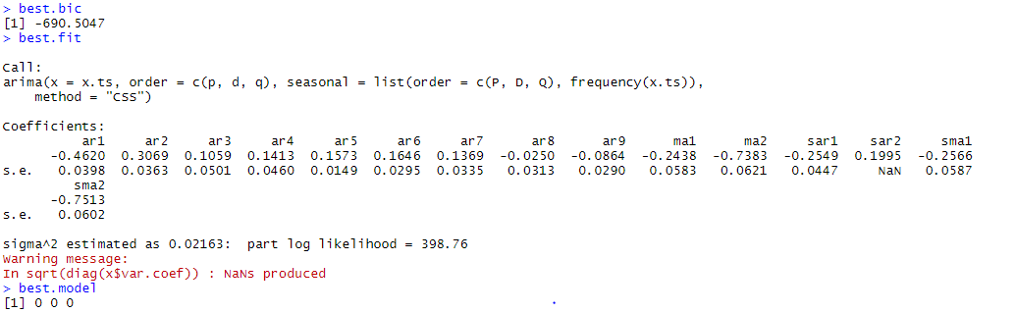
ARIMA : Kylie Jenner Time Series
ARIMA best BIC model
Best Model (0,0,0)
BIC = -690.5047

Slide 8
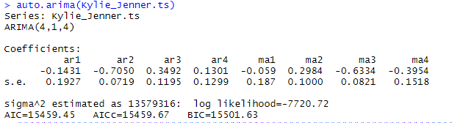
Auto.ARIMA : Kylie Jenner Time Series
auto.arima(Kylie_Jenner.ts)
Best Model (4,1,4)
BIC = 15501.63
Auto.arima function using Forecast library

Slide 9

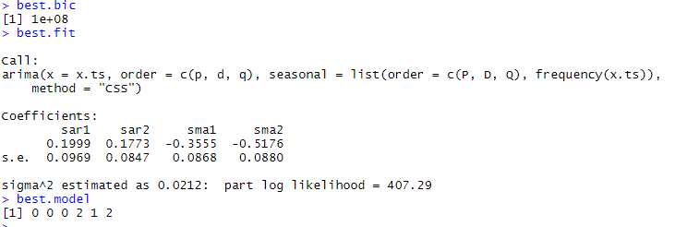
SARIMA : Kylie Jenner Time Series
SARIMA
Best Model (0,0,0,2,1,2)

Slide 10
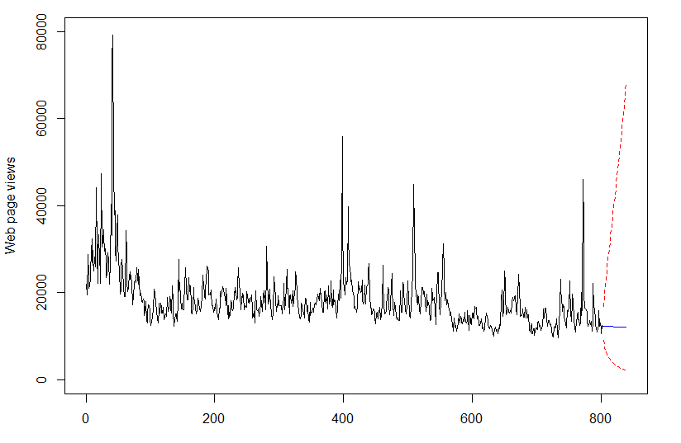
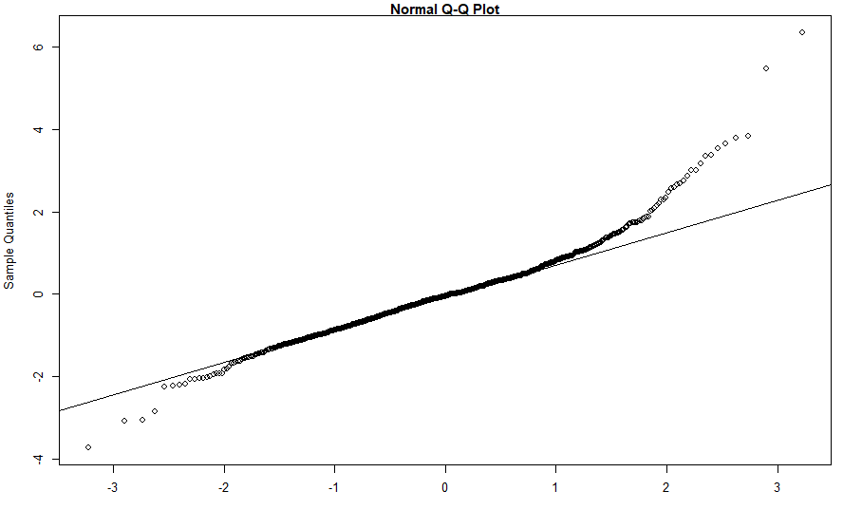
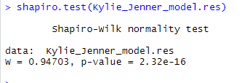
SARIMA vs DLM : Kylie Jenner Time Series
DLM
2nd order polynomial trend and a Fourier representation with all Fourier frequencies, S=12
P value is low so the null hypothesis must go.

Slide 11
Conclusion
A case study of Dynamic Linear Modeling vs Box Jenkins Methods
Time Series models can be successfully used for web-traffic forecasting by fitting the right model.
One should start at simple models and then proceed towards more complex models to find the best fit analysis
The supervised classification algorithm can be applied to further classify each of the algorithms
Future Work :
Classify other web-pages traffic with an algorithm that iterates from simplest model to more complex model with a top-down approach
The Machine Learning algorithm if based on Time Series models should take a top-down approach to model classification

Slide 12
Thank You!

